Slide 1
Pause to check out code
Matlab code for n=5 classification of CTLN attractors:
https://github.com/ccurto/n5-graphs-package
Matlab code for book chapter:
https://github.com/nebneuron/CTLN-bookchapter

Slide 2
Building new core motifs from old

Slide 3
Cyclic unions theorem

Slide 4
Cyclic unions theorem
Corollary: if each component has a unique fixed point, then so does the cyclic union.
**Cyclic unions of core motifs give new core motifs

Slide 5
Cyclic union core motifs

Slide 6
Cyclic union core motifs + generalizations

Slide 7
Generalizations of cyclic unions for more core motifs
Inductive argument of cyclic union theorem generalizes:

Slide 8
Emergent sequences: the basic problem
Why does the sequence 176345 emerge? Why does neuron 2 drop out?

Slide 9
Identify all surviving core motifs

Slide 10
Attractor predicted by surviving core motif

Slide 11
Attractor predicted by surviving core motif

Slide 12
Attractor predicted by surviving core motif

Slide 13
Engineering Networks with Prescribed Attractors

Slide 14
Engineering with core motifs
Survival rule: Since G has uniform in-degree 2
Fixed points survives no node outside G receives 3
(or more) edges from G

Slide 15
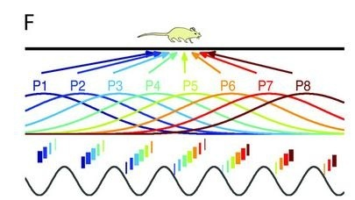
Engineering with core motifs

Slide 16
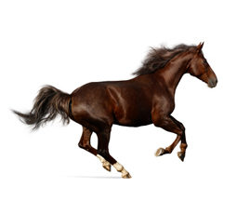

Engineering with cyclic union cores

Slide 17
Beyond cyclic unions to
directional chains and cycles

Slide 18
Directional graphs
A graph G is directional if there is a partition of the nodes
such that every fixed point of G is contained in .

Slide 19
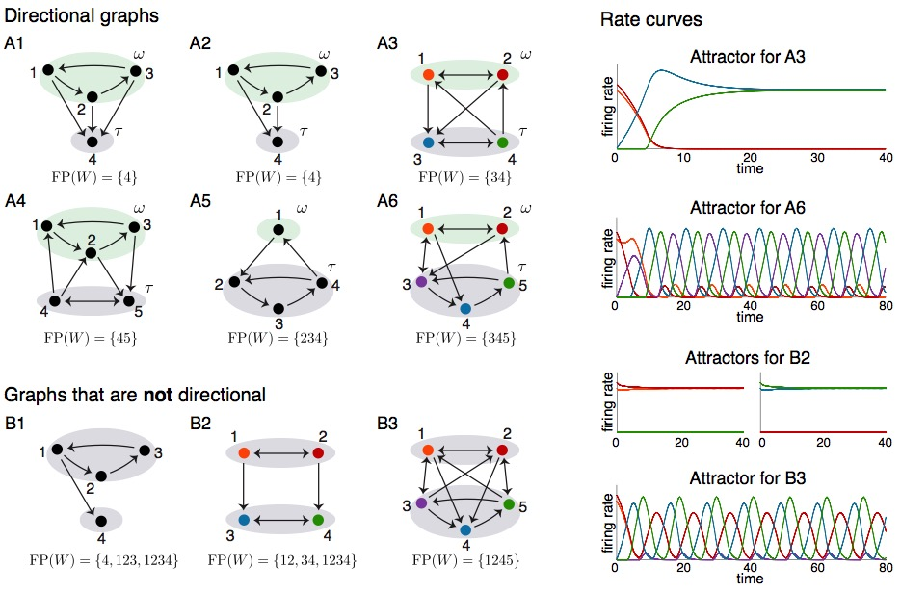
Directional graphs
A graph G is directional if there is a partition of the nodes
such that every fixed point of G is contained in .

Slide 20
Directional graphs
A graph G is directional if there is a partition of the nodes
such that every fixed point of G is contained in .

Slide 21
Directional graphs
A graph G is directional if there is a partition of the nodes
such that every fixed point of G is contained in .

Slide 22
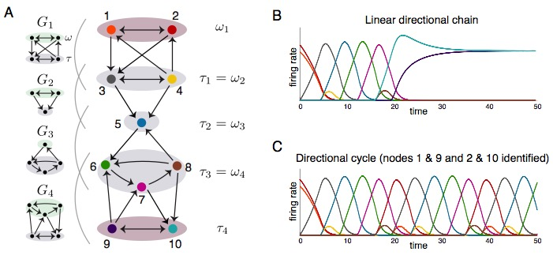
Chaining together directional graphs produces networks that generate sequences

Slide 23
Directional cycles have cyclic fixed point supports
Theorem. If G is a directional cycle with directional graphs
G₁, … , G_{m}, then every fixed point support contains an undirected cycle that hits each in cyclic order.

Slide 24
When do variations on cyclic unions yield similar cyclic attractors?
cyclic union
minus the 4 → 5 edge
**
minus the 4 → 5 edge
plus the 4 → 1 edge
minus the 4 → 5 and the 3 → 5 edges

Slide 25
When do variations on cyclic unions yield similar cyclic attractors?
Every cyclic union is a directional cycle
**
NOT a directional cycle for this partition of the nodes

Slide 26
Effect of Graph Symmetry on Attractors

Slide 27
Symmetries in the graph induce symmetries in the space of attractors

Slide 28
Order of components in cyclic union modulates effect of graph symmetries

Slide 29
Symmetries can yield spurious attractors beyond the Rule of Thumb

Slide 30
Symmetries can yield spurious attractors beyond the Rule of Thumb

Slide 31
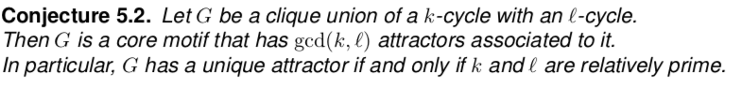
Symmetries can yield spurious attractors beyond the Rule of Thumb

Slide 32
Order in a cyclic union matters!

Slide 33
Symmetries can yield spurious attractors beyond the Rule of Thumb
Sequence 1234567
Sequence 1473625
Notes:
1234567 obvious sequence built in to network architecture. Second sequence 1473625 is more emergent – although in this case it is also still somewhat obviously built in to network

Slide 34
Beyond CTLNs:
To what extent does the graph
still shape the dynamics?

Slide 35
The graph of a TLN
Assume networks are inhibition-dominated (or competitive):
Idea: network of excitatory
and inhibitory cells
graph G
Question: What constraints does G_{W} place on the dynamics?

Slide 36
An example
initial conditions #1
initial conditions #2
Fixed points (supports):

Slide 37
An example
initial conditions #1
initial conditions #2
Fixed points (supports):
tipping point

Slide 38
An example
Neural activity state space (4 dimensional)
Fixed points (supports):
tipping point

Slide 39
Two dynamic regimes
same graph, different W
2 attractors:
1 attractor:
Fixed points (supports):

Slide 40
What does the graph G tell us about ?

Slide 41
What does the graph G tell us about ?
Up to n=2, it tells us everything:

Slide 42
What does the graph G tell us about ?
Up to n=2, it tells us everything:
For larger n, it’s not so clear:

Slide 43
Robust and flexible motifs
We say that a graph is a robust motif if
is identical for every with graph .
Otherwise, we say that G is a flexible motif.
Robust motifs are particularly meaningful because they constrain the TLN dynamics so that certain features (namely, the fixed point structure) are completely independent of the choice of W.
So, the actual values of the connection strengths do not matter too much!
Up to n=2, all the graphs are robust motifs.

Slide 44
Robust and flexible motifs
We say that a graph is a robust motif if
is identical for every with graph .
Otherwise, we say that G is a flexible motif.
Robust motifs are particularly meaningful because they constrain the TLN dynamics so that certain features (namely, the fixed point structure) are completely independent of the choice of W.
So, the actual values of the connection strengths do not matter too much!
Up to n=2, all the graphs are robust motifs.
Problem: What are the other robust motifs?
Do they even exist for n > 2?

Slide 45
FP(W) constraints for all n=3 graphs

Slide 46
Characterization of robust motifs for all n
Theorem: All robust motifs (other than the 3-cycle and the size 2 WTA motif)
are precisely the graphs in the two families DAG1 and DAG2.

Slide 47
Characterization of robust motifs for all n
Theorem: All robust motifs (other than the 3-cycle and the size 2 WTA motif)
are precisely the graphs in the two families DAG1 and DAG2.

Slide 48
Characterization of robust motifs for all n
Theorem: All robust motifs (other than the 3-cycle and the size 2 WTA motif)
are precisely the graphs in the two families DAG1 and DAG2.

Slide 49
Characterization of robust motifs for all n
Theorem: All robust motifs (other than the 3-cycle and the size 2 WTA motif)
are precisely the graphs in the two families DAG1 and DAG2.

Slide 50
Some ideas that go into the proofs…

Slide 51
Proof ingredients
1. Graph rules, “threshold-linear algebra,” and related concepts/tools such as domination, developed initially for CTLNs in:
and further developed in:
C. Curto, J. Geneson, K. Morrison. Fixed points of threshold-linear networks. Neural Comp., 2019, available at https://arxiv.org/abs/1804.00794
C. Curto, C. Langdon, K. Morrison. Robust motifs of threshold-linear networks. Preprint available at https://arxiv.org/abs/1902.10270
C. Curto, C. Langdon, K. Morrison. Combinatorial geometry of threshold-linear networks. Preprint available at https://arxiv.org/abs/2008.01032

Slide 52
Proof ingredients
2. Key idea: characterization of fixed point supports via sign conditions.
3. Some new technology for studying TLNs: oriented matroids

Slide 53
FP(W) constraints for all n=3 graphs

Slide 54
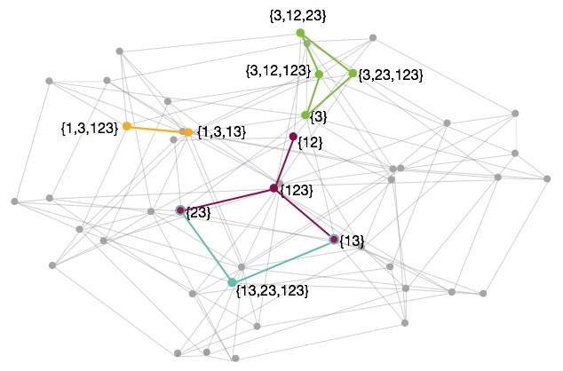
Mutations of the oriented matroids correspond to bifurcations in the fixed point structure

Slide 55
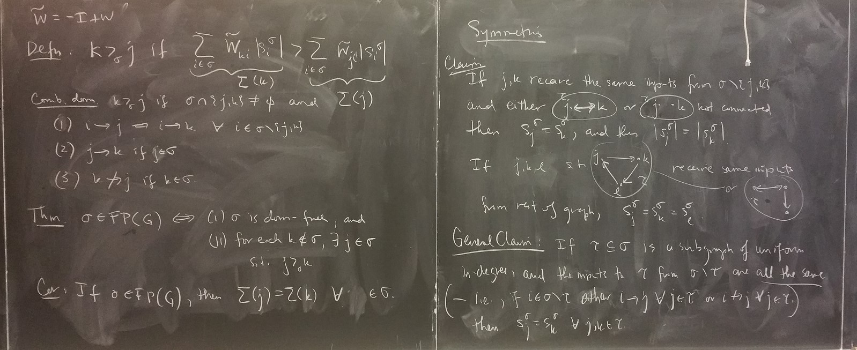


Thanks!
main contributors to this work:
Katie Morrison (U. of Northern Colorado)
Jesse Geneson (postdoc @ Penn State)
Chris Langdon (postdoc @ Penn State)
Caitlyn Parmelee (Keene State College)
some other collaborators:
Anda Degeratu (Stuttgart)
Vladimir Itskov (Penn State)
Joshua Paik, Sumita Garai
Funding: NIH R01 EB022862, NSF DMS 1516881

